Slide 1
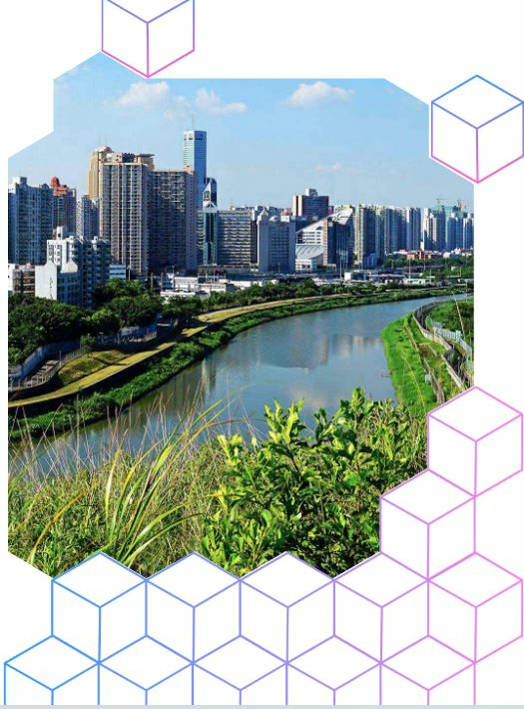


Business Strategies for Combating Climate Change, Resource Scarcities and Social Inequality:
A Sustainable Tomorrow in the Indian Perspectives
Prof. Bharat Raj Singh
Director General (Technical),
School of Management Sciences, Lucknow brsingh@smslucknow.ac.in
+91 9415025825
www.brsinghindia.com

Slide 2
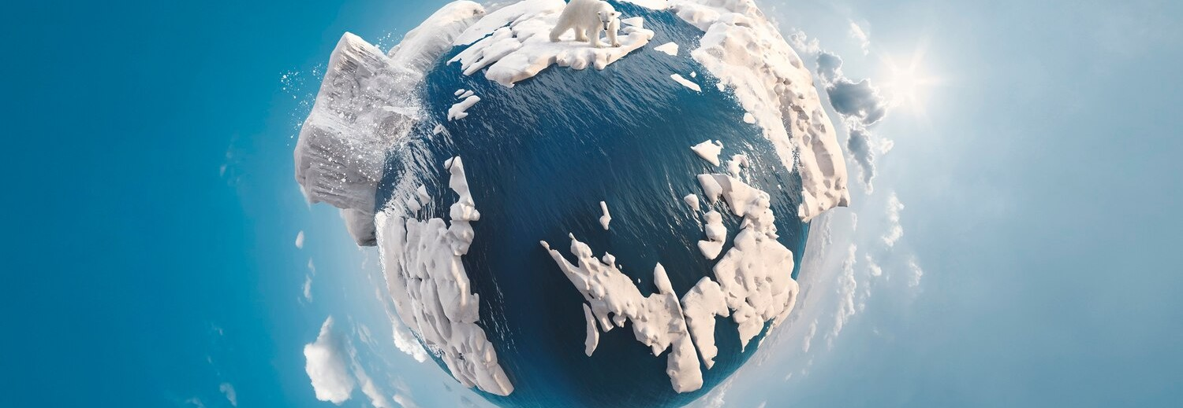
Contents-
Introduction
The Urgency of the Issue in India
Business Responsibility
Circular Economy in India
Triple Bottom Line (TBL) Approach
Green Supply Chains
Social Entrepreneurship in India
Role of Technology in Sustainable Practices
Renewable Energy Adoption
Water Conservation and Waste Management
Challenges to Sustainability
Government Policies and Regulatory Support
Future Outlook for Indian Businesses
Conclusion

Slide 3
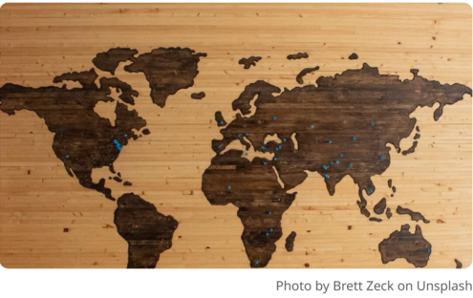
Global Challenges:
The world faces existential threats from climate change, diminishing resources, and widening social inequality, which threaten sustainable development at every level.
Focus of Presentation:
This presentation will detail targeted business strategies in India that can effectively tackle these challenges through innovative and sustainable practices.
Introduction

Slide 4
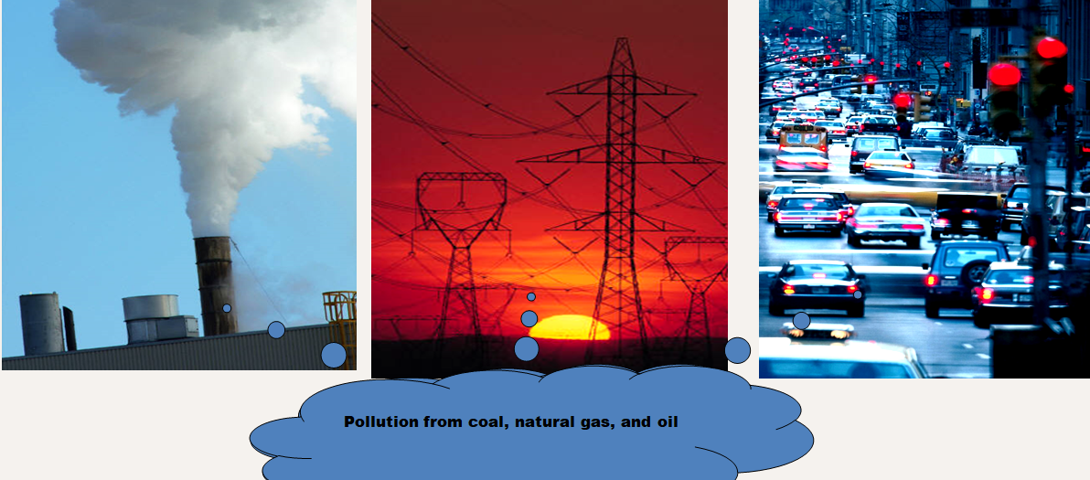
Science of Global Warming
Understanding the mechanism at play
Greenhouse Gas Emissions: Human activities, suchas burning fossil fuels, deforestation, and industrial processes, have led to unprecedented levels of greenhouse gases in the atmosphere, trapping heat and disrupting natural climate regulation.
Climate Change Mechanisms: The greenhouse effect, driven by gases like CO2 and methane, creates a feedback loop that exacerbates climate change effects, including changing weather patterns and increased extreme weather events.
Temperature Rise and Its Effects: The consequences of rising global temperatures are multi-faceted, leading to heatwaves, altered precipitation patterns, and significant impacts on ecosystems and human infrastructure.

Slide 5

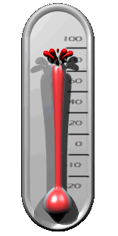



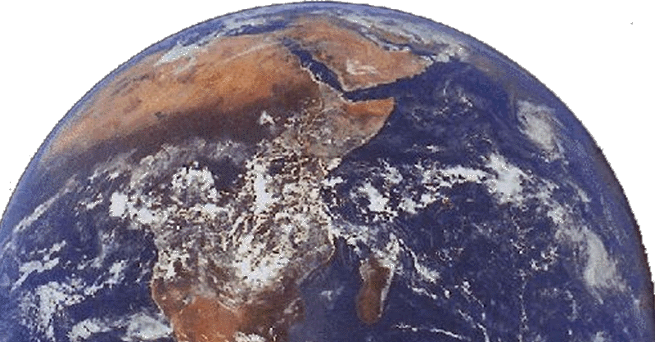


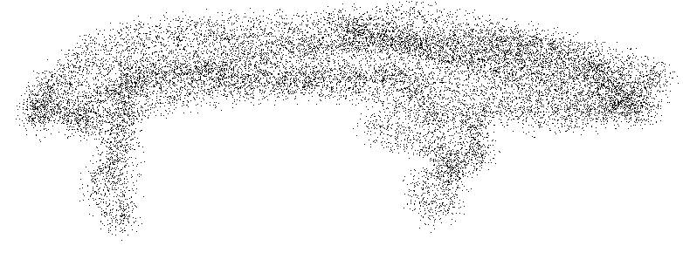
How Global Warming Works?
Carbon Dioxide (CO₂)
Fossil fuels (coal, oil, natural gas)
creates Green House Gases

Slide 6
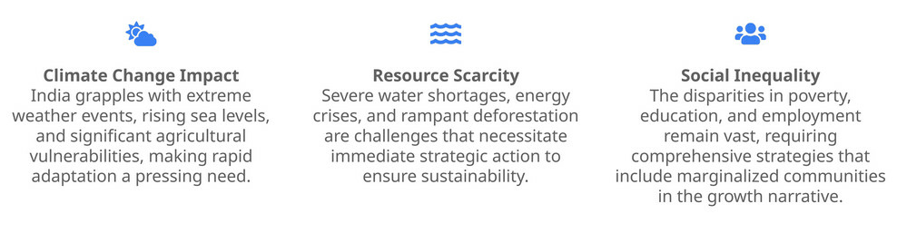
The Urgency of the Issue in India
A Nation at the Frontline of Climate Crisis

Slide 7
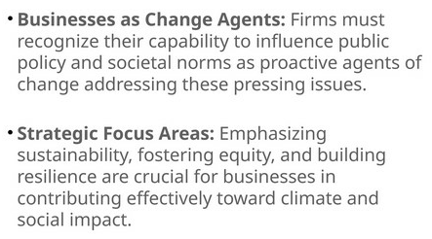
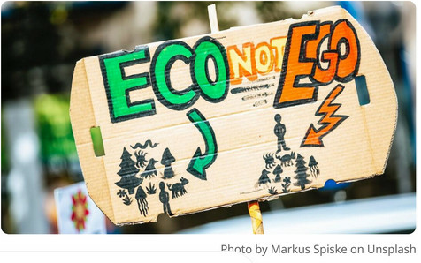
Business Responsibility
Leveraging Corporate Influence for Positive Change

Slide 8
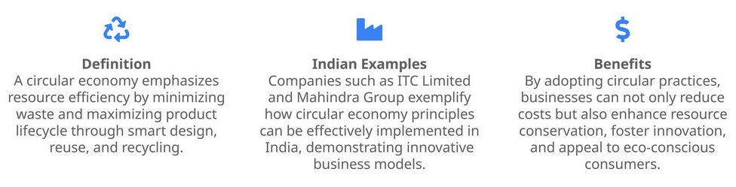
Circular Economy in India
Redefining Growth Through Sustainability

Slide 9
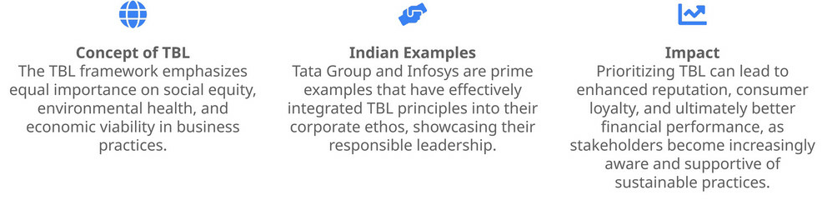
Triple Bottom Line (TBL) Approach
Balancing People, Planet and Profit

Slide 10
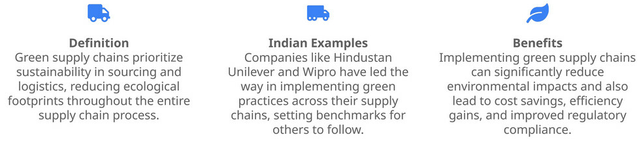
Green Supply Chains
Integrating Sustainability into Logistics

Slide 11
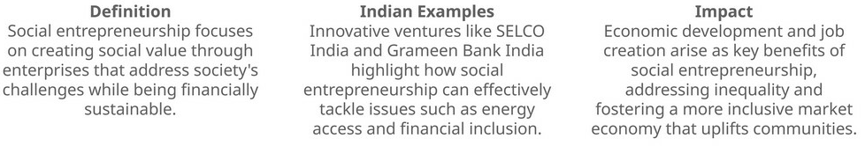
Social Entrepreneurship in India
Innovation for Societal Benefits

Slide 12
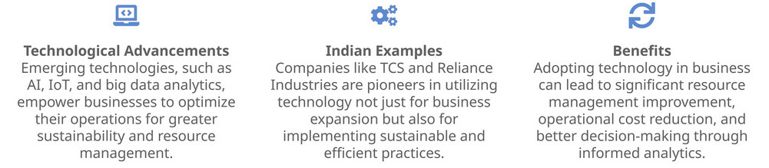
Role of Technology in Sustainable Practices
Leveraging Innovations for Efficiency

Slide 13
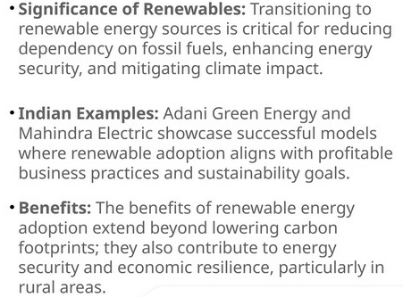
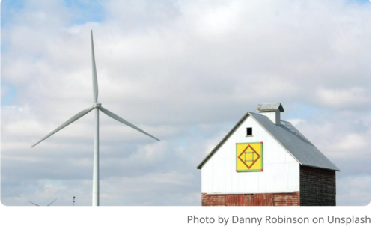
Renewable Energy Adoption
The Future of Energy India

Slide 14
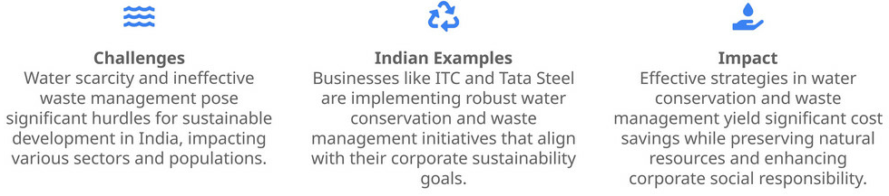
Water Conservation and Waste Management
Strategies for Sustainable Resource Management

Slide 15
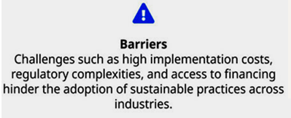
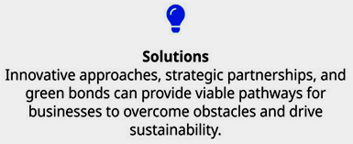
Challenges to Sustainability
Navigating the Complex Terrain

Slide 16
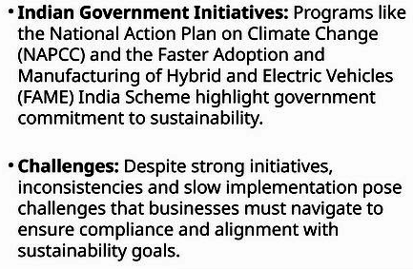
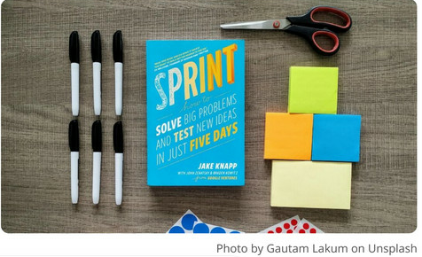
Government Policies and Regulatory Support
Navigating Framework for Sustainability

Slide 17
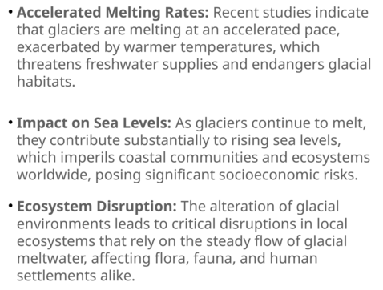
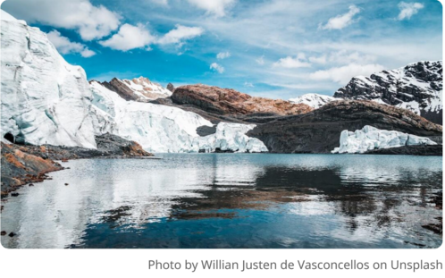
Glacier Melting: Causes and Consequences
The Unraveling Ice Caps

Slide 18
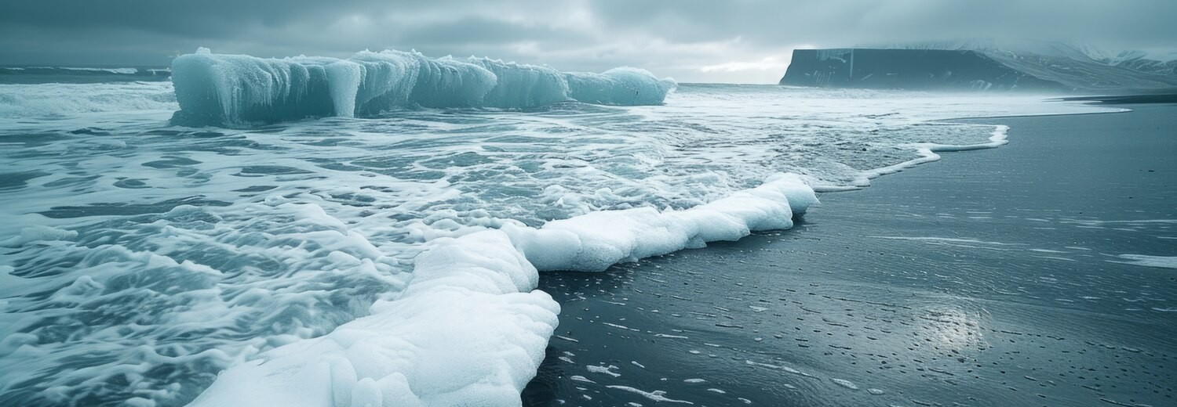
Glacier Melting Acceleration
They release fresh water into oceans, disrupting marine ecosystems and altering ocean current.
This can lead to extreme weather patterns, affecting agriculture and biodiversity. The interconnectedness of these systems highlights the urgency of addressing climate change.

Slide 19
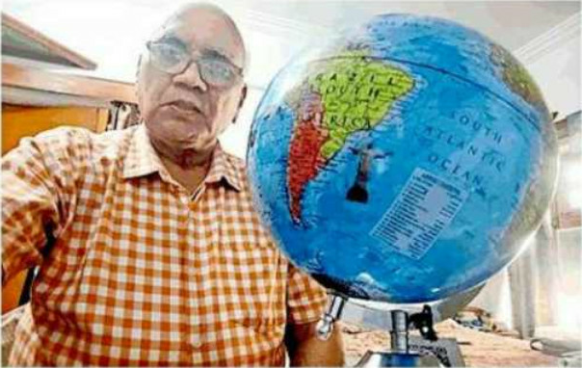
Earth's Deceleration Phenomenon
Global warming is causing the deceleration of the Earth's rotation. This phenomenon can lead to shifts in climate patterns and affect natural cycles.
Understanding these changes is essential for predicting future environmental impacts and preparing for their consequences.

Slide 20
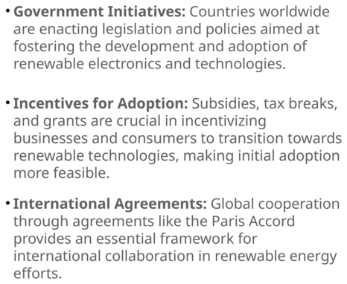
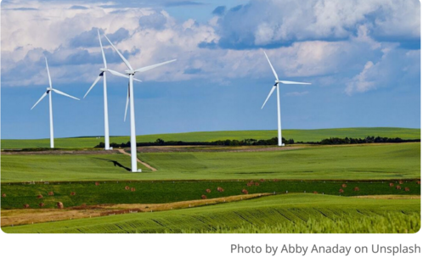
Policy and Regulation: Supporting Renewable Energy
A Framework for Growth

Slide 21
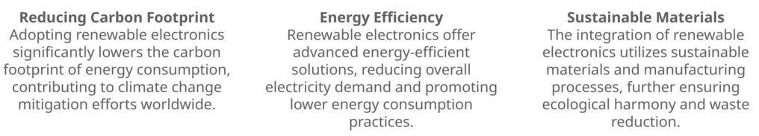
How Can Renewable Energy Mitigate Environmental Damage ?
Pathways to a Sustainable Future

Slide 22

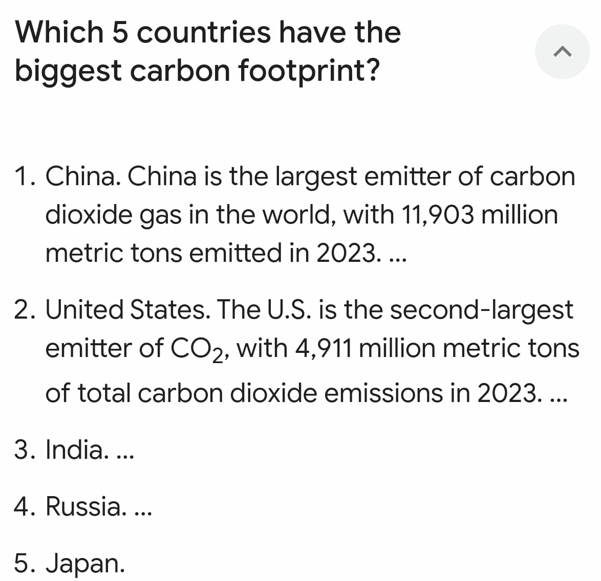
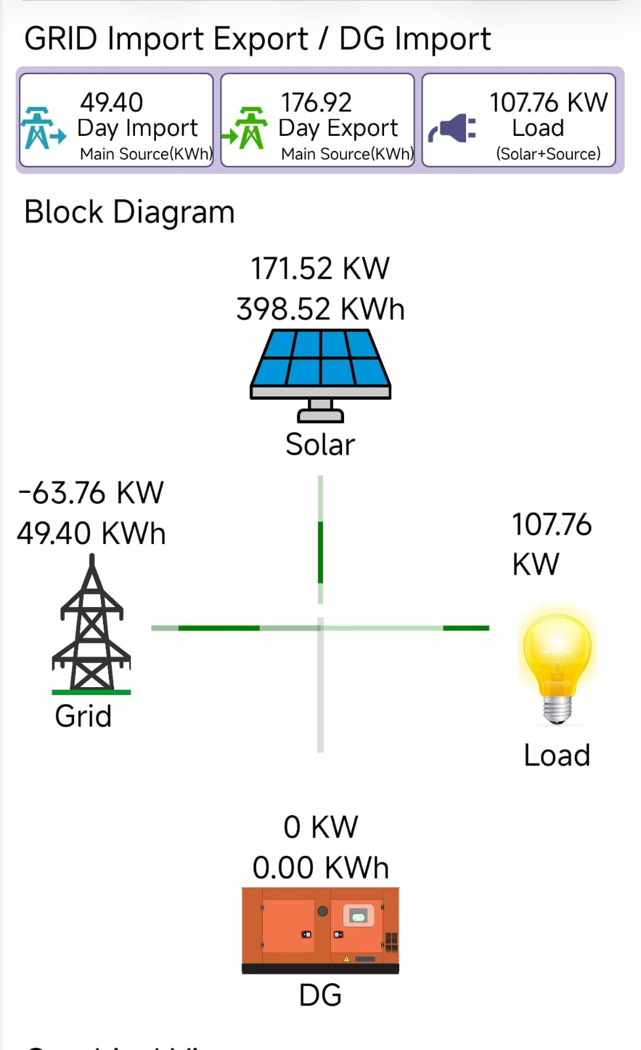
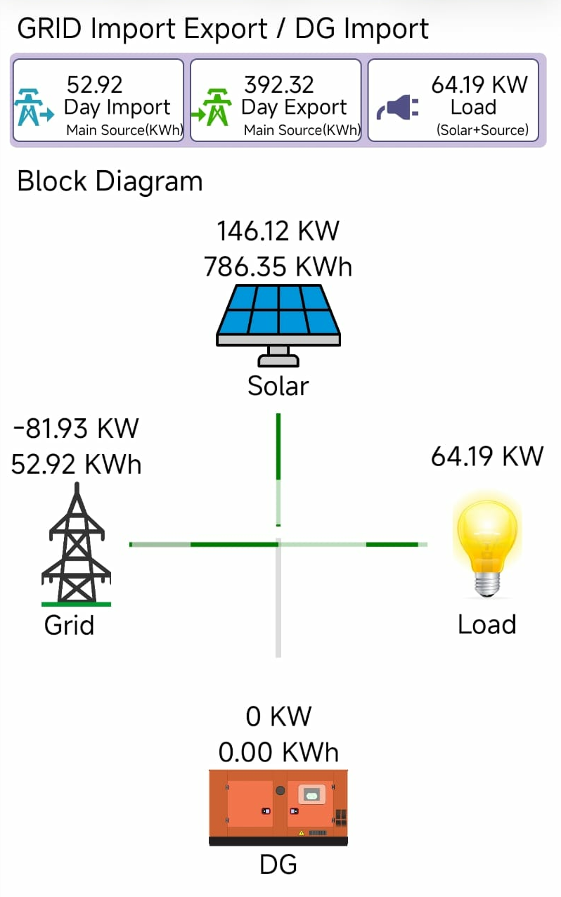
How Can Renewable Energy Mitigate Environmental Damage ?
Contribution of the SMS, Lucknow to a Sustainable Future

Slide 23
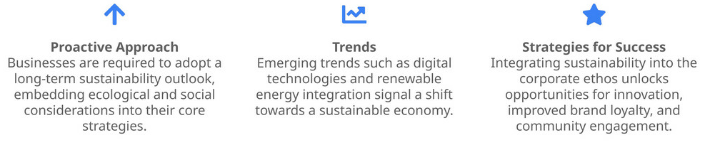
Future Outlook for Indian Business
Charting a Path towards Sustainability

Slide 24
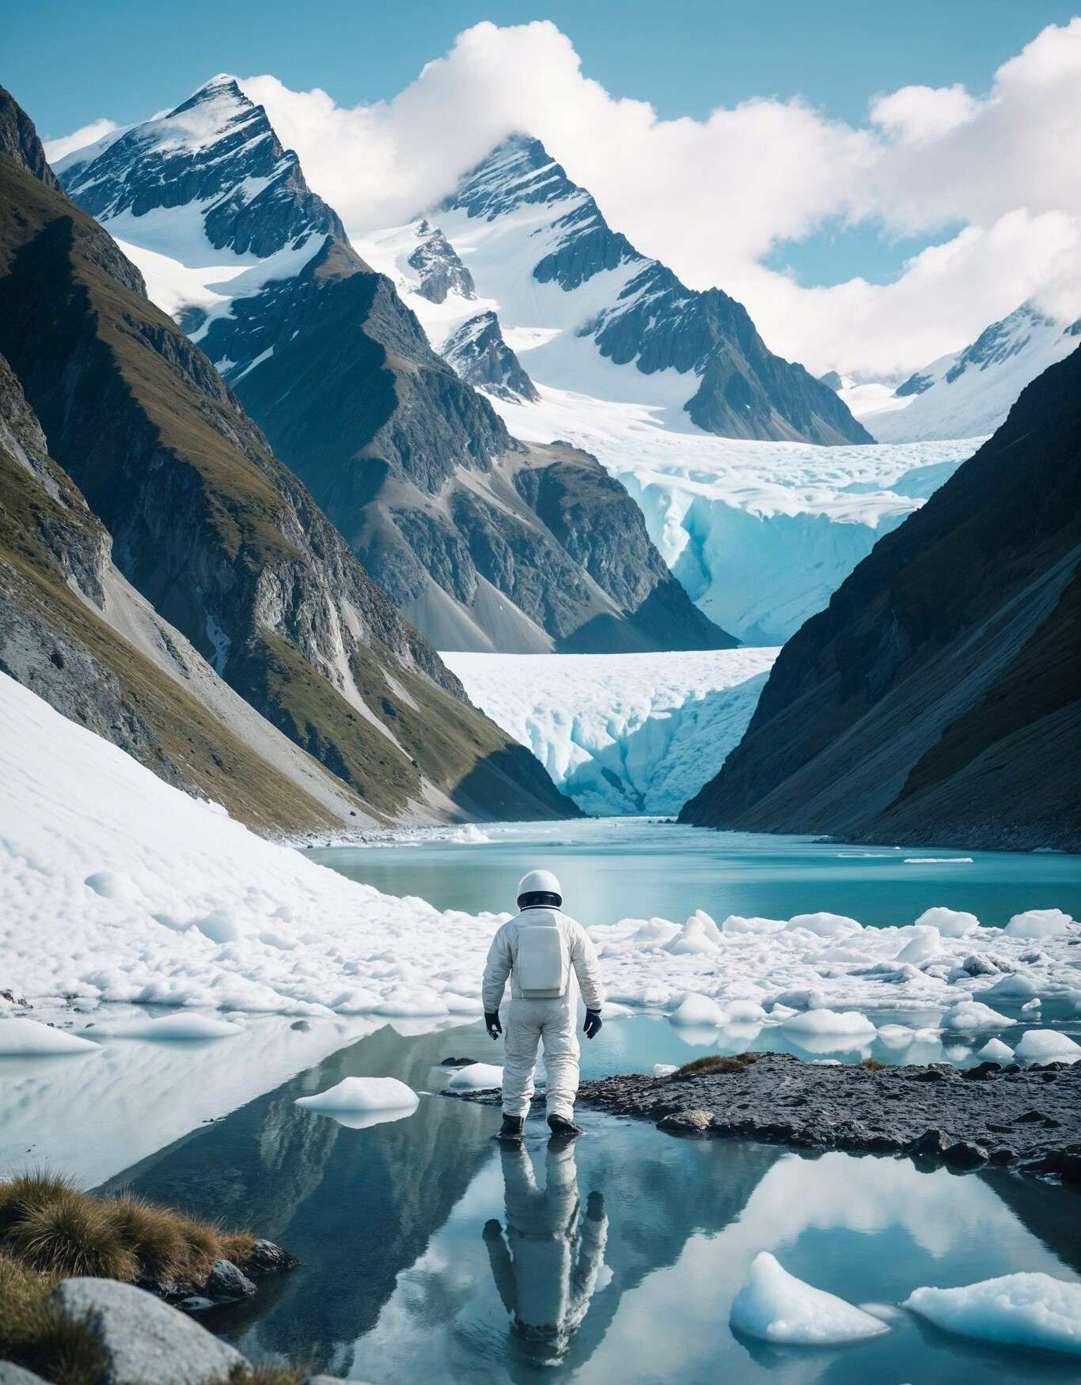
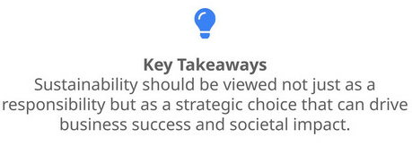
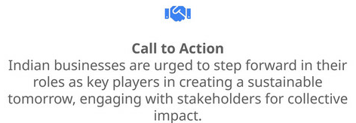
Conclusion
Strategic Choices for a Sustainable Future

Slide 25
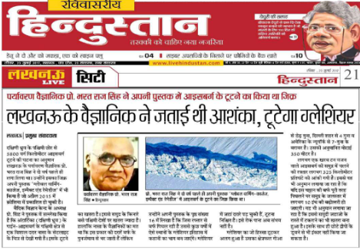
Media & News
Pine Iceberg 5800 sq.km broken on 17th Jul 2017

Slide 26
Thanks!
SAVE EARTH-SAVE LIFE
Any Question
???
brsingh@smslucknow.ac.in
+91 9415025825
www.brsinghindia.com
@brsinghlko

